Slide 1
CSET301 – AI-ML
Lecture 13 : Boosting Methods

Slide 2
Outline
Boosting methods
Adaboost
Gradient Boosting

Slide 3
Gradient Boosting
The main idea behind this algorithm is to build models sequentially and these subsequent models try to reduce the errors of the previous model.
But how do we do that? How do we reduce the error? This is done by building a new model on the errors or residuals of the previous model.

Slide 4

Gradient Boosting
When the target column is continuous, we use Gradient Boosting Regressor whereas when it is a classification problem, we use Gradient Boosting Classifier.
The only difference between the two is the “Loss function”.
Loss functions like Mean squared error (MSE) are used for regression, and
For classification, loss function used is Log-likelihood.

Slide 5
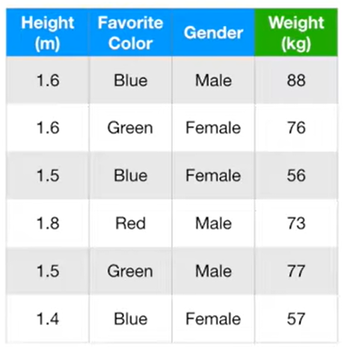

Gradient Boosting: Example
Here, we want to predict the weight of each person.
Gradient Boost starts by making a leaf instead of a tree or a stump.
This leaf represents the initial guess for the target variable of all samples.

Slide 6
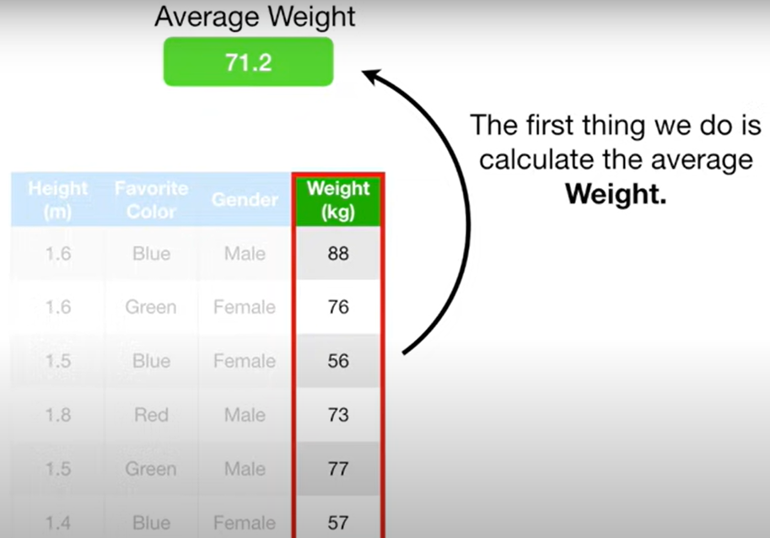
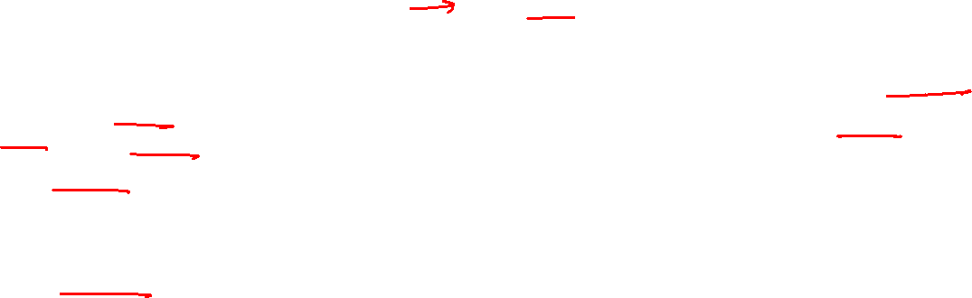
Gradient Boosting: Example
In this example, since Weight is a continuous value, initial guess will be its average value.
This node will become our first single-node tree.

Slide 7

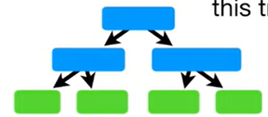

Gradient Boosting: Example
After this, Gradient Boost builds a tree.
Like Adaboost, this tree is based on the errors made by the previous tree but unlike Adaboost, this tree is larger than stump.
But Gradient Boost still restricts the size of the tree. Like here, it is a tree with 4 leaves.
Like Adaboost scales the stumps, Gradient boost also scales the tree, however it scales all trees by the same amount.

Slide 8
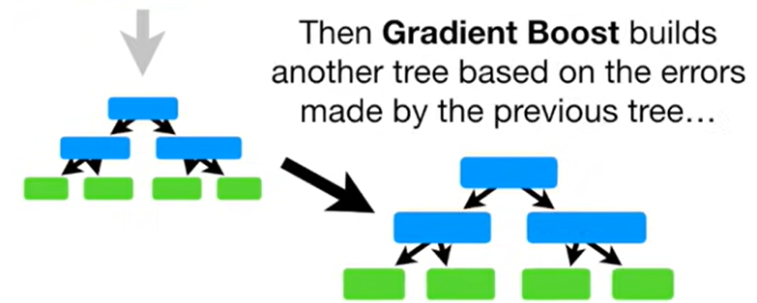

Gradient Boosting: Example
And gradient boost continues to build trees in this fashion until it has made the num of trees you asked for, or additional trees fail to improve the fit.

Slide 9
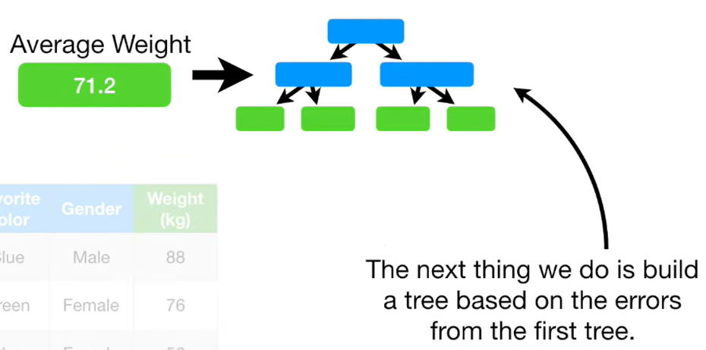


Gradient Boosting: Example
Now going back to our example:
Gradient boost first creates a leaf tree with average weight as the value.
Errors are the differences between the actual weights and predicted weights.
Notes:
Now going back to our example

Slide 10
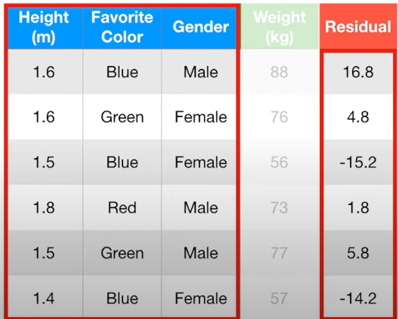
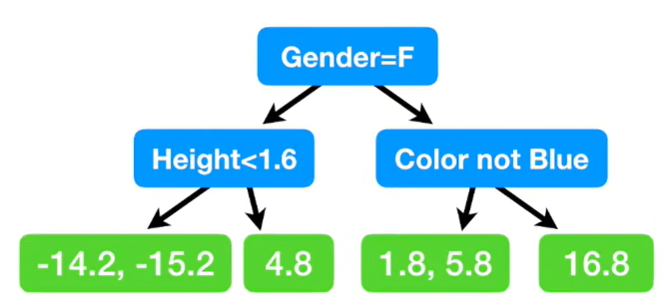

Gradient Boosting: Example
Residual represents the error for each row/sample.
Now we will build a tree using Height, Fav color, and Gender to predict the residuals.
Lets say this is the tree we build.
Notes:
Now going back to our example

Slide 11
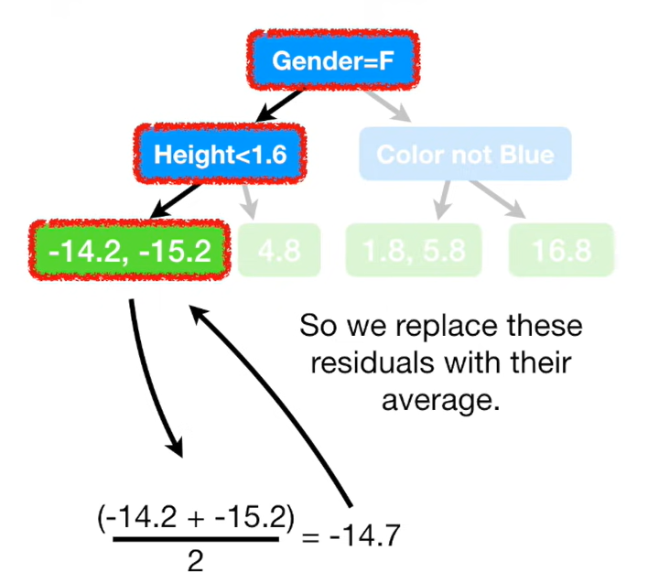
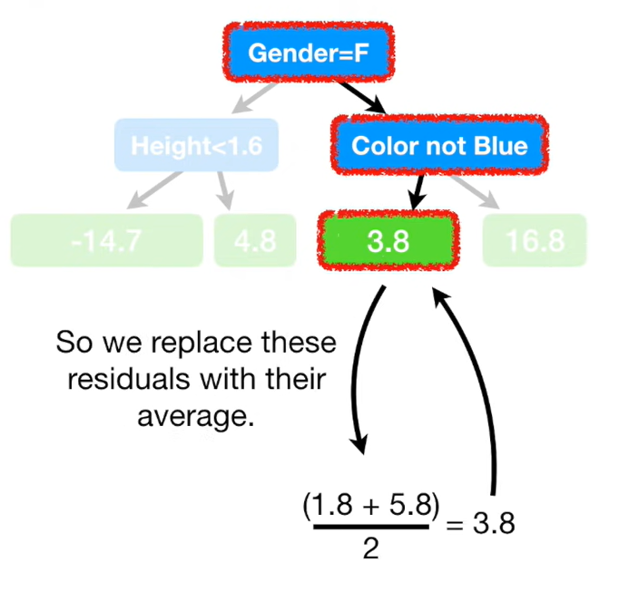

Gradient Boosting: Example
Since leaf nodes contain single values, we will take the average of values where multiple values exist at a leaf node.
Notes:
Now going back to our example

Slide 12
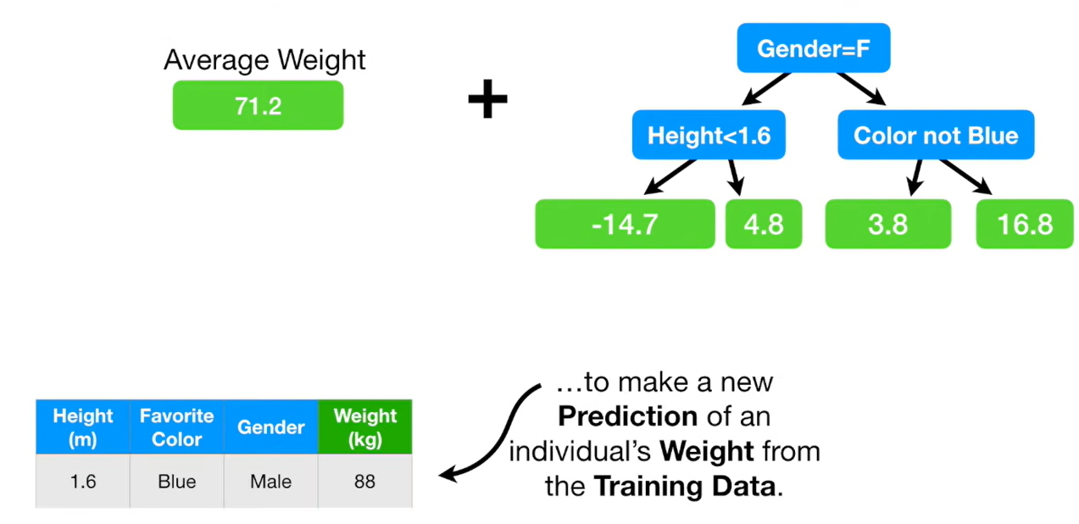
Gradient Boosting: Example
This is the tree we get
Notes:
Now going back to our example

Slide 13
Gradient Boosting: Example
Now we combine these two trees to make our prediction of weight.
Notes:
Now going back to our example

Slide 14
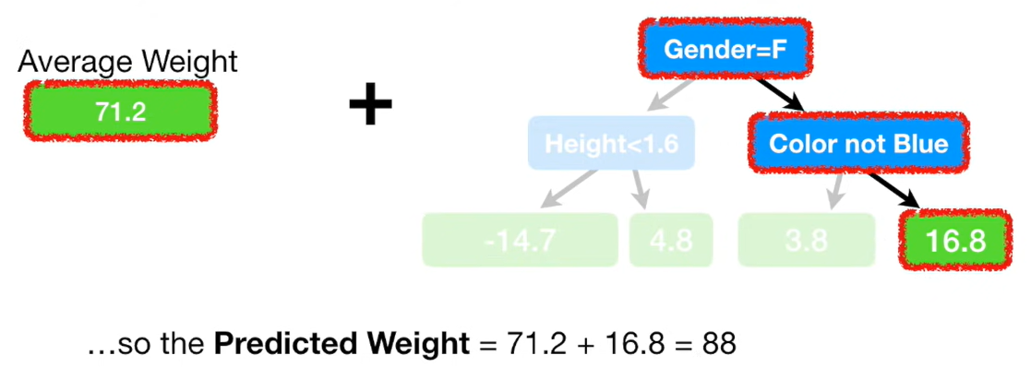
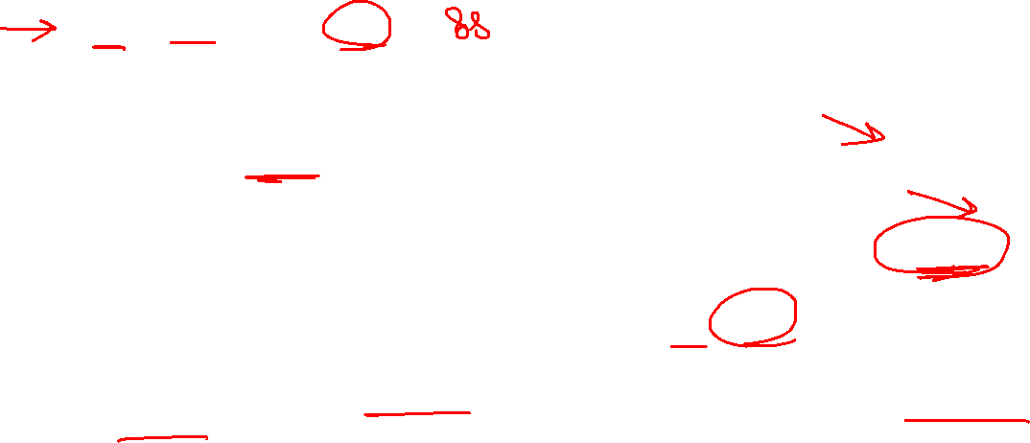
Gradient Boosting: Example
Lets say for this sample/row: Predicted weight will be calculated as:
But this is same as the observed weight. That is, the model fits the training data too well. - Overfitting
Notes:
Now going back to our example

Slide 15
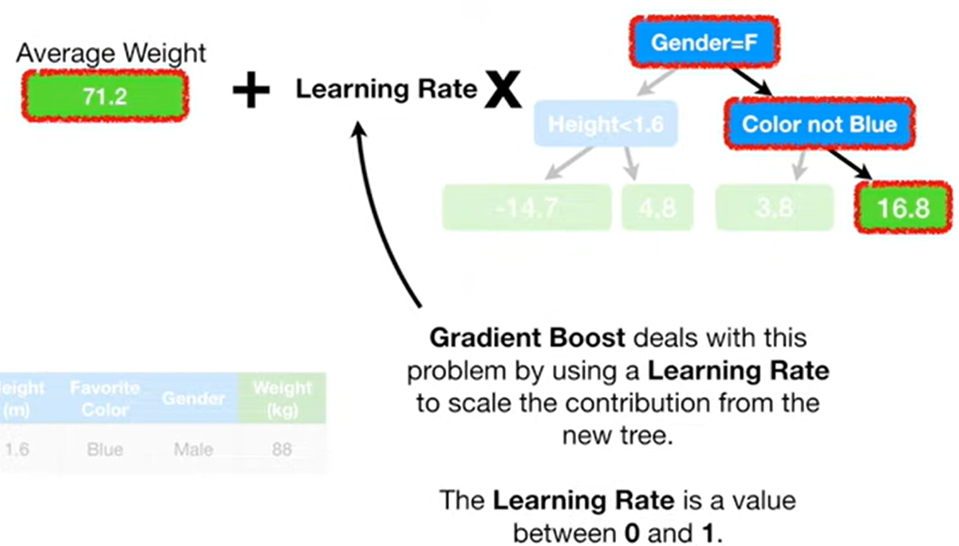


Gradient Boosting: Example
Notes:
Now going back to our example

Slide 16
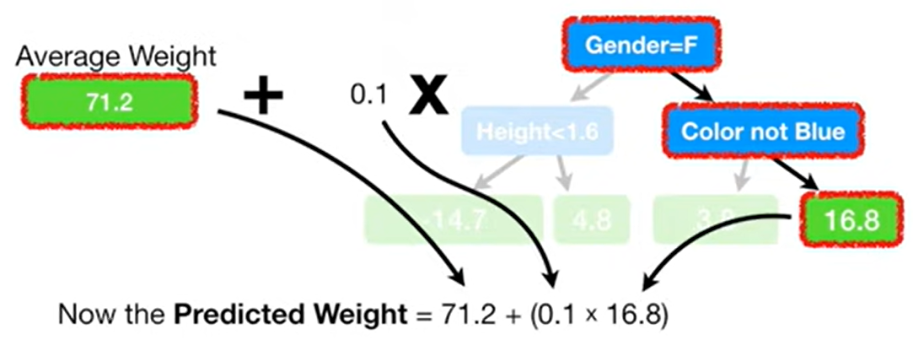
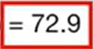
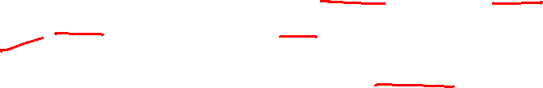
Gradient Boosting: Example
Lets say Learning Rate is taken to be 0.1
So, with Learning rate = 0.1, the prediction now is not as good as it was before, but it is little better than the prediction made with just the original leaf, which predicted that all samples would weigh 71.2.
So, scaling the tree with learning rate results in a small step towards the right direction.
Notes:
Now going back to our example

Slide 17
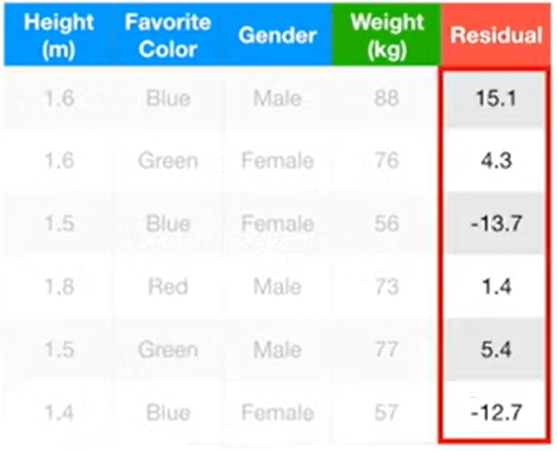

Gradient Boosting: Example
Now again for building next tree, we calculate residuals (that is, actual weights – predicted weights) using our latest predictions from the new tree we just built.
Notes:
Now going back to our example

Slide 18
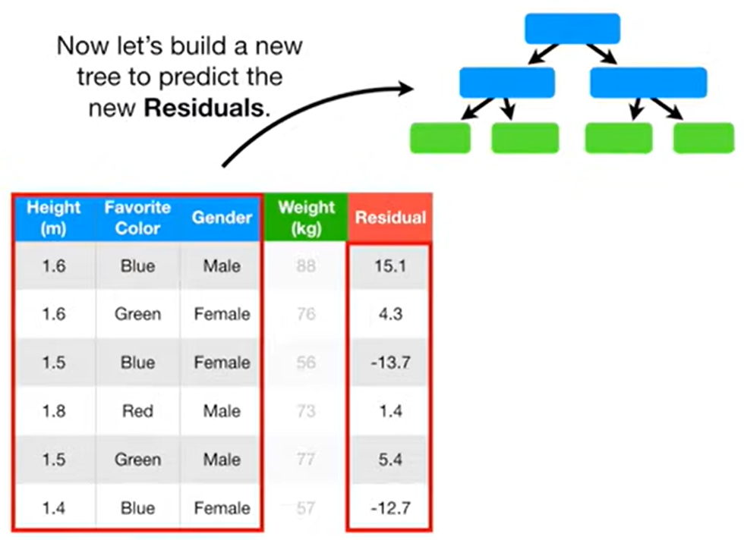
Gradient Boosting: Example
Notes:
Now going back to our example

Slide 19
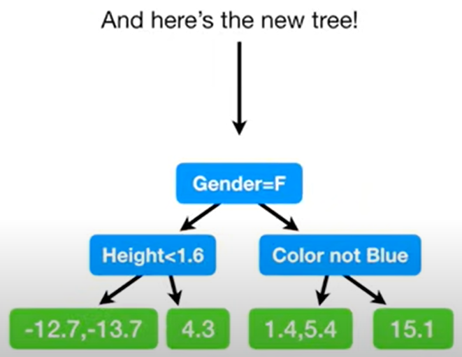

Gradient Boosting: Example
Note: in this example, the branches are the same as before, while in practice the trees can be different each time.
Notes:
Now going back to our example

Slide 20
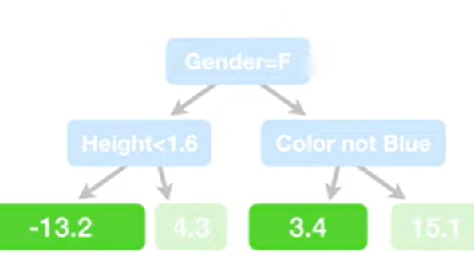
Gradient Boosting: Example
As next step, we take the average of residuals at leaf node
Then, we combine the new tree with previous ones
Notes:
Now going back to our example

Slide 21
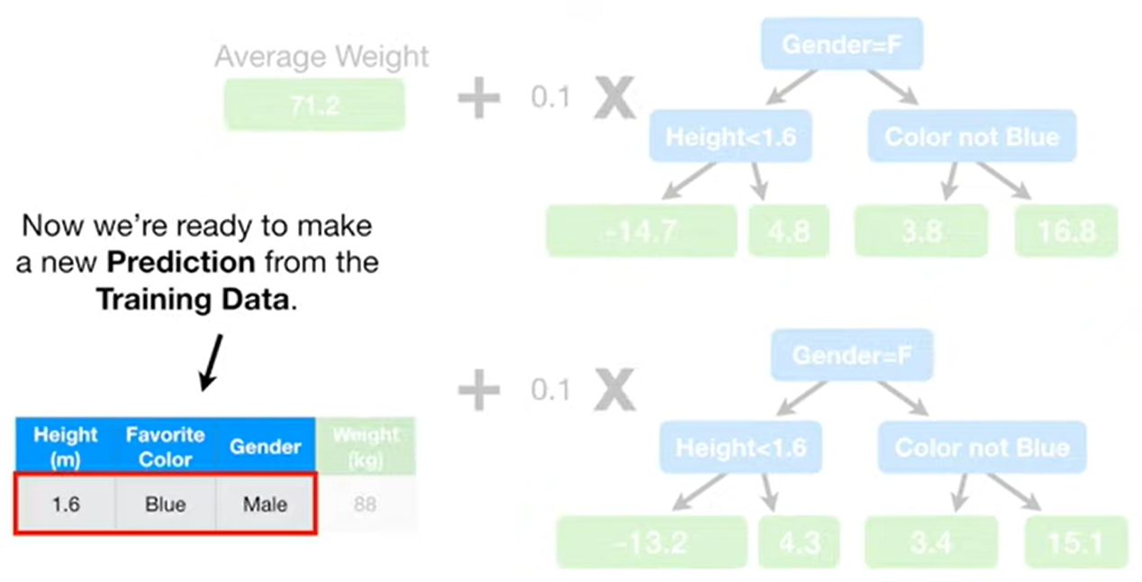

Gradient Boosting: Example
Then, we combine the new tree with previous ones to make new predictions
Notes:
Now going back to our example

Slide 22
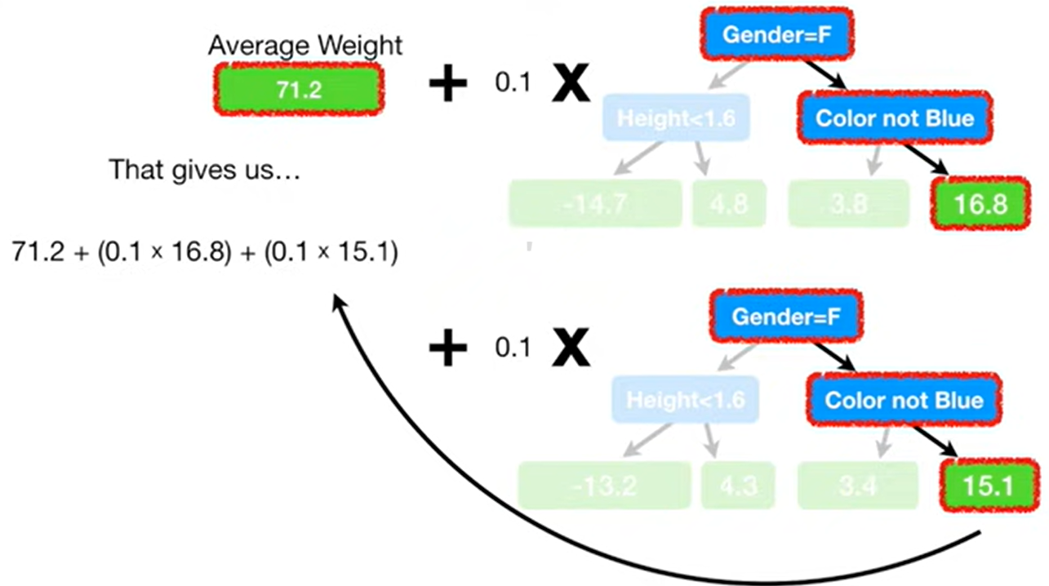
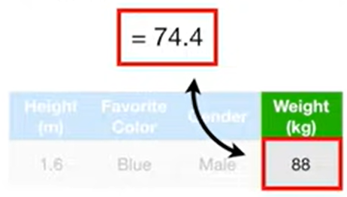

Gradient Boosting: Example
Then, we combine the new tree with previous ones to make new predictions

Slide 23

Gradient Boosting: Example
Similarly, we can make predictions for all samples using single leaf + scaled values from 1st tree + scaled values from 2nd tree. And can then find the residuals.
Each time we add a tree to the predictions, the residuals get smaller.
Likewise, we create a chain of trees, each time reducing the residuals.
We keep doing this until we reach the maximum specified, or adding additional trees does not significantly reduce the size of the residuals.
Once all trees are built (training is done), we can make predictions for the test data set.

Slide 24
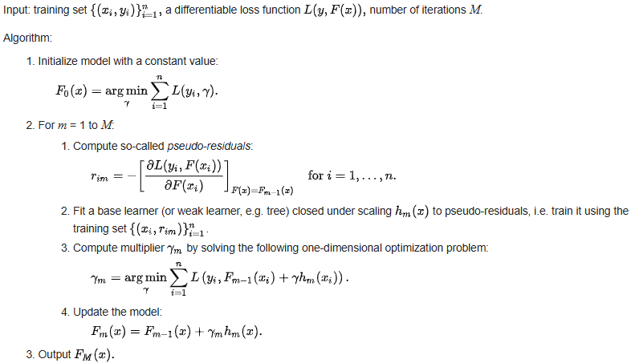
Gradient Boosting Algorithm

Slide 25
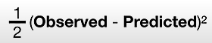
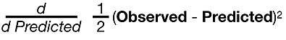

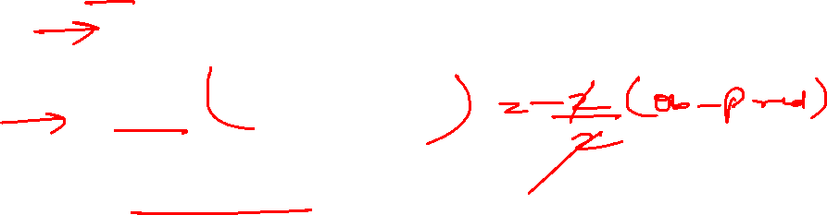
Gradient Boosting Algorithm
Loss function that is used for regression is :

Slide 26
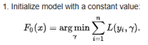




Gradient Boosting Algorithm
Argmin over gamma means we need to find a predicted value that minimizes the sum. To find this, we take the derivative of L and equals it to 0.
In the example covered earlier to find weights, this will give us the average weight.

Slide 27
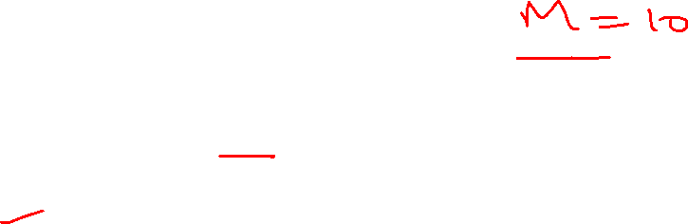

Gradient Boosting Algorithm

Slide 28
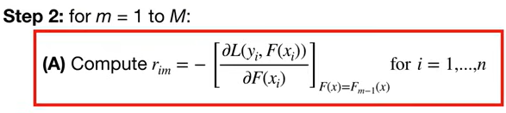











Gradient Boosting Algorithm

Slide 29





Gradient Boosting Algorithm

Slide 30
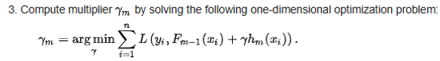












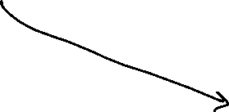










Gradient Boosting Algorithm

Slide 31
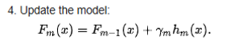










Gradient Boosting Algorithm
After step 2, M trees will be created. Then step 3 is to output the prediction from final Mth tree.

Slide 32
Feature Selection, Engineering and extraction
Aspect | Feature Engineering | Feature Selection | Feature Extraction
Meaning | Creating and modifying features from raw data | Choosing the most relevant subset of existing features | Transforming existing features into a new reduced set of features.
Goal | Make features more informative for the model | Remove irrelevant features, improve accuracy and efficiency | Reduce dimensionality while preserving important information.
How it works | Generate new features using domain knowledge | Apply statistical tests, correlation checks | Apply mathematical models like PCA, LDA, Autoencoders
Data Size | Increases (add more features) | Decreases (removes unnecessary features) | Decreases (compresses features)
Example | From Date → create Day, Month, Year; From height & weight → BMI | Drop HairColor & ShoeSize when predicting diabetes | Reduce 1000 gene features → 50 principal components with PCA.
Techniques | Scaling, Binning, encoding | Chi-square, ANOVA | PCA, LDA, SVD, Autoencoders

Slide 33

Feature Selection, Engineering and Extraction
Aspect | Feature Engineering | Feature Selection | Feature Extraction
Meaning | Creating and modifying features from raw data | Choosing the most relevant subset of existing features | Transforming existing features into a new reduced set of features.
Goal | Make features more informative for the model | Remove irrelevant features, improve accuracy and efficiency | Reduce dimensionality while preserving important information.
How it works | Generate new features using domain knowledge | Apply statistical tests, correlation checks | Apply mathematical models like PCA, LDA, Autoencoders
Data Size | Increases (add more features) | Decreases (removes unnecessary features) | Decreases (compresses features)
Example | From Date → create Day, Month, Year; From height & weight → BMI | Drop HairColor & ShoeSize when predicting diabetes | Reduce 1000 gene features → 50 principal components with PCA.
Techniques | Scaling, Binning | Chi-square, ANOVA | PCA, SVD, LDA, Autoencoders
When to use | Always the first step after raw data collection | When you want to simplify model and avoid overfitting | When data is very high-dimensional (genomics data)

Slide 34
Reference
https://datamapu.com/posts/classical_ml/gradient_boosting_regression/
https://www.youtube.com/watch?v=2xudPOBz-vs

Slide 35
Thank You

